Slide 1

Transforming Supplier Price Quote Management Manual Process Vs. Agentic AI Automation Conceptual Demo
Notes:
AI-generated content may be incorrect. --- This presentation explores the transition from the traditional manual supplier price quote process to an advanced agentic AI automation demo using N8n. We will review the current manual workflow, visualize it, introduce the automated workflow, and discuss its impact and benefits.

Slide 2

Agenda Overview
Overview of the Manual Supplier Price Quote Process
Current Manual Workflow Visualized
Automating the Process with Agentic AI Workflows
Visualizing the Automated Workflow
Impact, Benefits, and Next Steps
Notes:
We will begin with an overview of the manual supplier price quote process, followed by a visualization of the current workflow and its challenges. Next, we will introduce the automated workflow powered by agentic AI, visualize this new process, and conclude with the impact, benefits, and future steps.

Slide 3
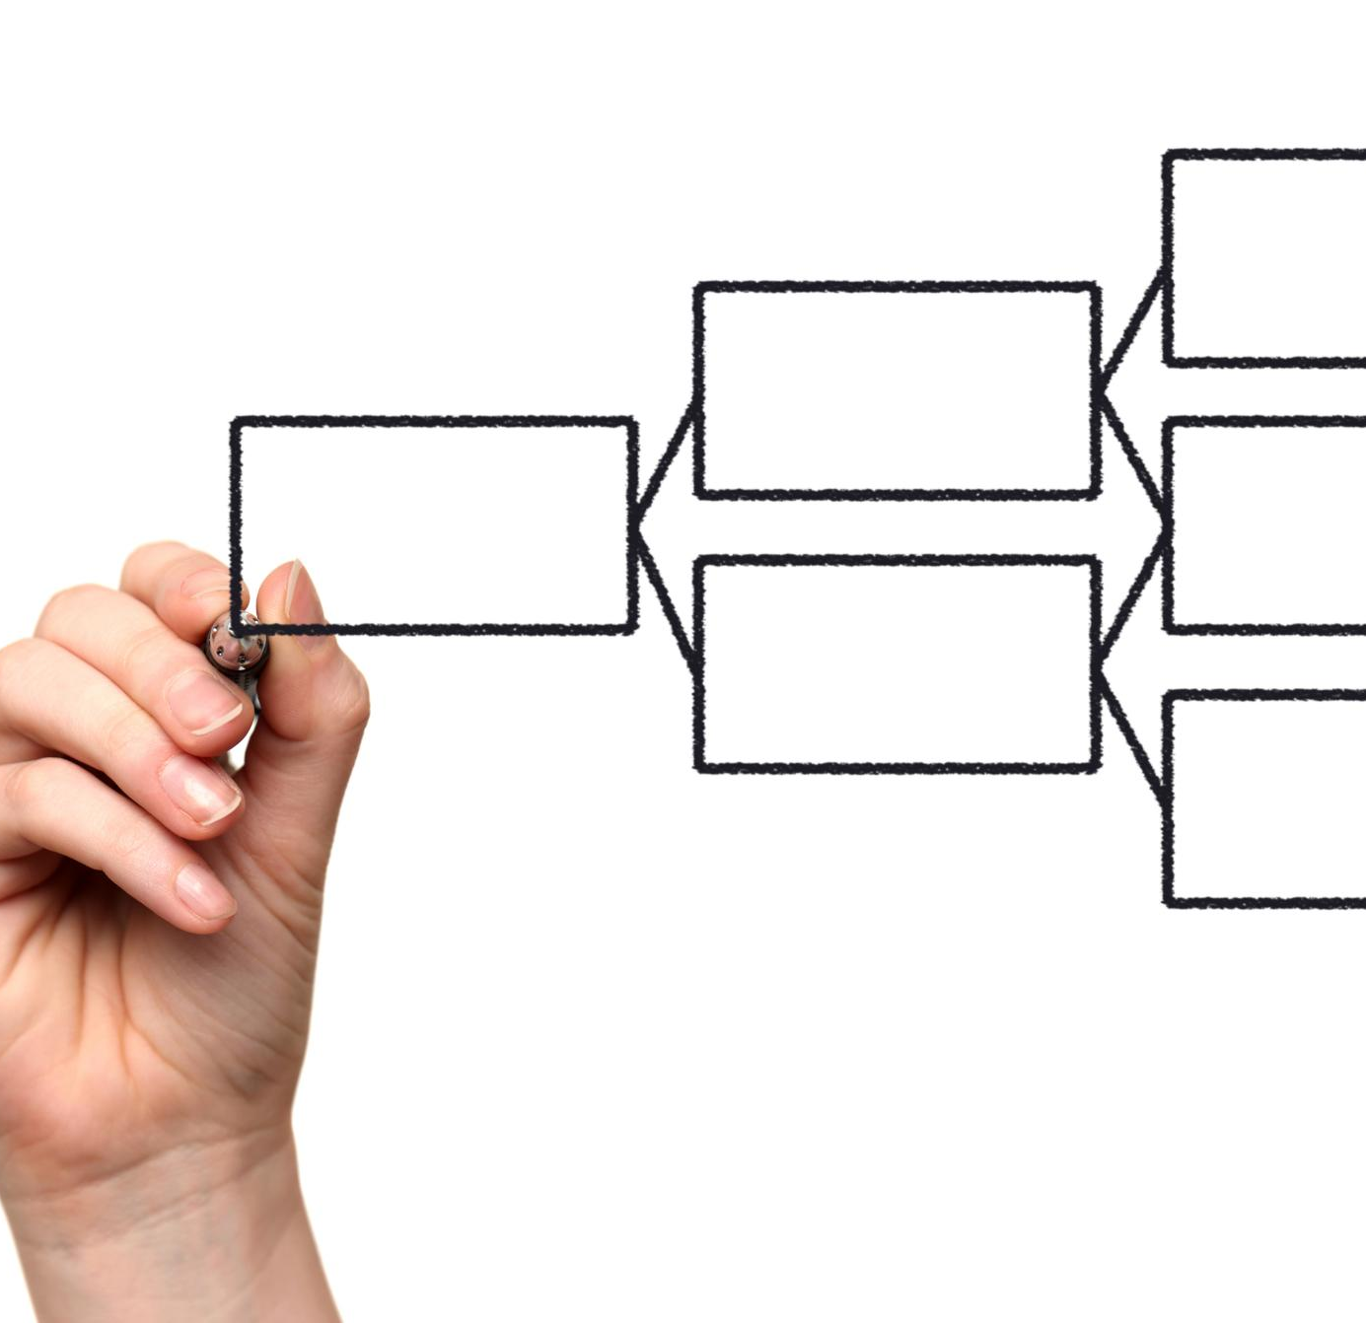
Current Manual Supplier Price Quote Process
Notes:
The introduction of N8n agentic AI workflows aims to automate repetitive tasks while retaining essential human oversight, streamlining the supplier price quote process.

Slide 4





Manual Supplier Price Quote Process – Overview
Initiation & Coordination
Supplier Follow-Ups
Quote Analysis
Schedule Manager Review
Documentation & Archiving
Quarterly Process Start
The request for price quotes is initiated each quarter to gather supplier pricing information.
Manual Coordination
Timely communication and coordination among procurement analysts are essential.
Manual Follow-Ups
Manual follow-ups with suppliers are essential to maintain timely communication and progress.
Query Management Challenges
Handling queries and clarifications along with follow-ups often leads to delays and increases team workload.
Quote Analysis Process
Human review of received quotes to ensure quality of material received.
Manual Evaluation
Supplier selection relies on manual assessment among procurement analysts.
Human Judgment Role
Human expertise reviews and signs off the final analysis.
Scheduling Challenges
Manual coordinating schedules among multiple managers causes delays in the proposal review process.
Importance of Documentation
Documenting meetings is essential for maintaining accurate records.
Archiving Proposals
Archiving proposals preserves important decisions and supports future reference and audits.
Manual Workload Challenges
Manual documentation and archiving increase workload.

Slide 5







Flowchart of New Automated Process
Initiate RFQ
Draft Decision Meeting Minutes
No
Coordinate Management
Meeting Schedule
Wait & Follow-up
All quotes collected & reviewed
Review quote
Address Question
Management Discuss Decision
Yes
Meeting Minutes Manager Review
Propose
Sign-off or Rework
Reviewed Supplier Response Archived
Best Offer Comparison Analysis
Best Offer Proposal Manager Review
Decision Archived
Analyst
Manager
Supplier
Critical human decision
Best Offer Proposal Archived
Notes:
--- A detailed flowchart breaks down each manual step, showcasing the sequence from initiation through archiving, providing clarity on the process flow and dependencies. Image source: Microsoft 365 content library

Slide 6
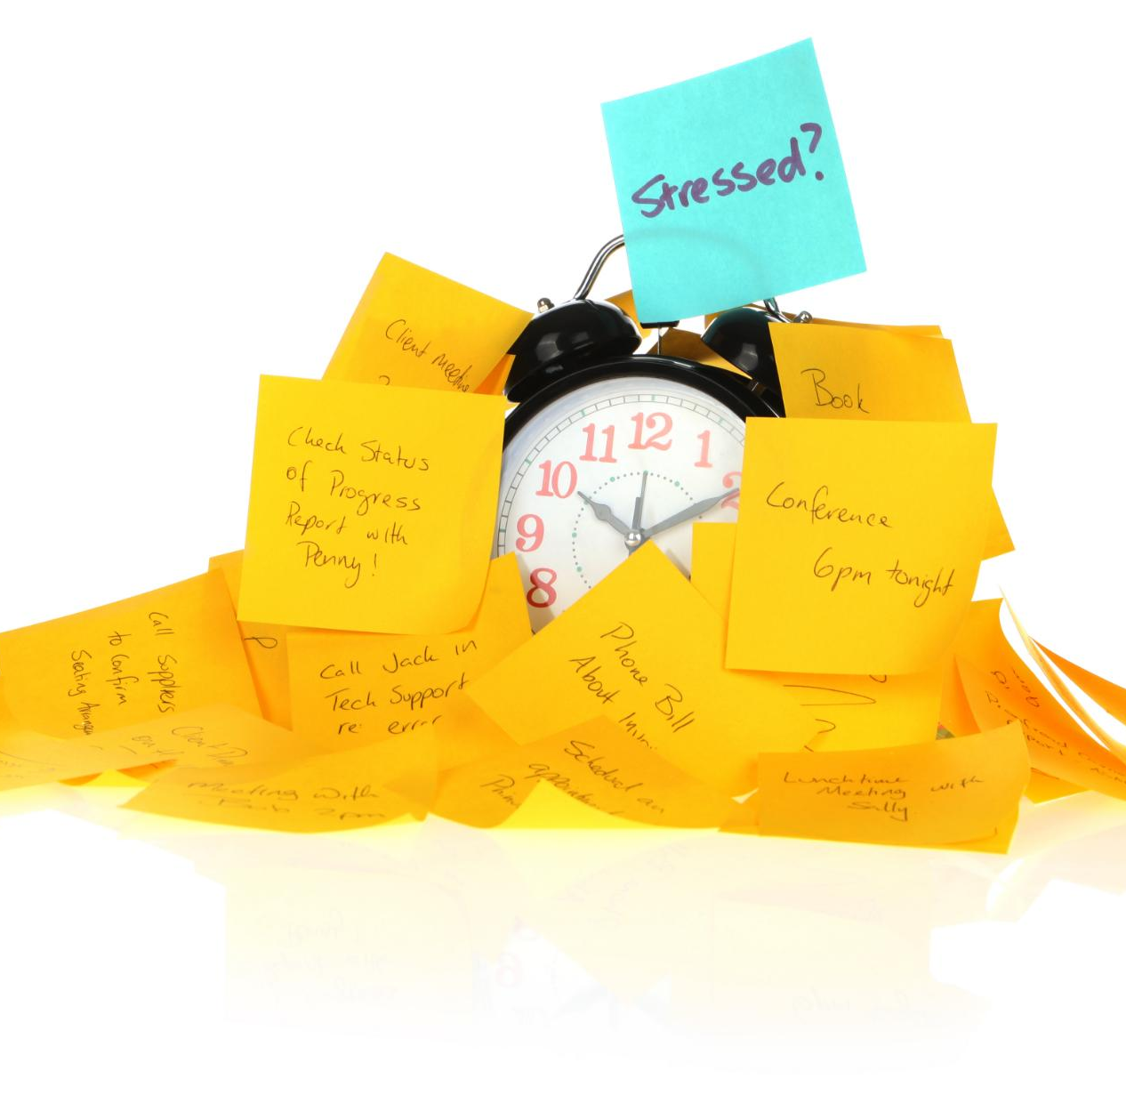
Key Pain Points and Inefficiencies
Supplier Delays
Delays occur frequently due to the need to chase suppliers for information and deliveries.
Manual Analysis
Manual data analysis consumes excessive time and increases the risk of errors.
Meeting Coordination Challenges
Scheduling and coordinating meetings is difficult and causes project slowdowns.
Documentation and Archiving
Documentation and archival requirements burden the team and reduce overall efficiency.
Notes:
--- Pain points include delays due to chasing suppliers, manual analysis, coordination challenges for meetings, and extensive documentation efforts, all contributing to inefficiencies. Image source: Microsoft 365 content library

Slide 7

Automating the Process with Agentic AI Workflows
Notes:
The introduction of N8n agentic AI workflows aims to automate repetitive tasks while retaining essential human oversight, streamlining the supplier price quote process.

Slide 8
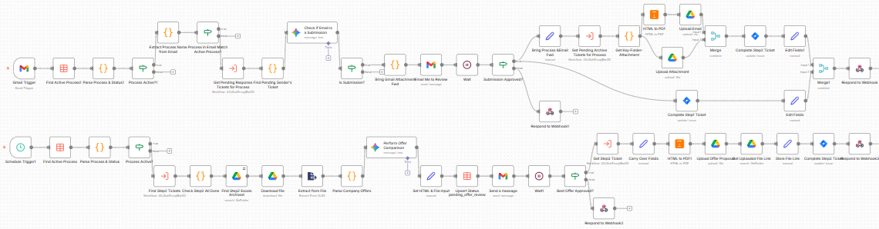
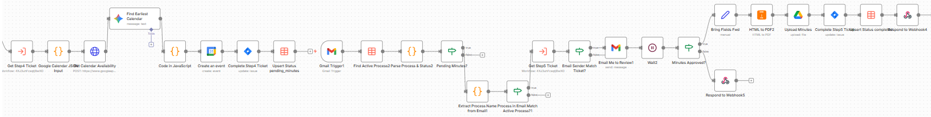
Flowchart of New Automated Process
Automated Request for Quote Initiation and Follow-up
Streamlined Supplier Quote Review and Best Offer Analysis
Automated Management Meeting Scheduling and Decision Archival
Notes:
--- This flowchart illustrates the automated steps from initiating quotes to final documentation, showing streamlined interactions and reduced manual touchpoints. Image source: Microsoft 365 content library

Slide 9

Automated Workflow Architecture and Key Features
AI-driven Task Management
AI enhances task management by automating scheduling and prioritization, increasing operational efficiency and accuracy.
Supplier Communication Integration
Automated communication streamlines supplier interactions, improving coordination and reducing delays.
Data Processing Efficiency
AI-powered data and archiving processing accelerates workflows and minimizes manual errors, ensuring data consistency.
Notes:
--- The automated workflow integrates AI-driven task management, supplier communications, and data processing, improving speed and consistency while reducing manual errors. Image source: Microsoft 365 content library

Slide 10
Human-in-the-Loop Responsibilities
Critical Review Oversight
Procurement analyst or manager review of supplier’s responded quotes meeting the company’s requirement
Decision-Making Role
Procurement manager review of proposed best offer and sign-off
Additional management meeting to discuss the proposal and record final decision
Quality Control Assurance
Final decision meeting minutes is reviewed by procurement manager before signed off for archiving
Notes:
--- Despite automation, humans continue to oversee critical review points and decision-making, ensuring quality control and handling exceptions effectively. Image source: Microsoft 365 content library

Slide 11

Impact, Benefits, and Next Steps
Notes:
Concluding with the benefits realized from automation, this section also outlines future plans to scale and enhance the agentic AI workflows further.

Slide 12

Time and Resource Savings
Reduced Follow-Up Time
Minimizing time spent on follow-ups allows focus on core tasks and enhances work efficiency.
Decreased Manual Processing
Automation of manual tasks saves resources and accelerates operations.
Improved Productivity
Freed resources can be redirected to higher-value activities, boosting overall productivity.
Notes:
--- Significant reductions in time spent on follow-ups and manual processing free resources for higher-value activities and improve overall productivity. Image source: Microsoft 365 content library

Slide 13

Quality Control with Human Checkpoints
Human Oversight Importance
Human checkpoints provide essential quality control to complement automated systems effectively.
Balancing Automation and Expertise
Automation supports tasks while human expertise guides and verifies outputs for accuracy.
Notes:
--- Critical human checkpoints maintain quality and oversight, ensuring that automation complements rather than replaces human expertise. Image source: Microsoft 365 content library

Slide 14
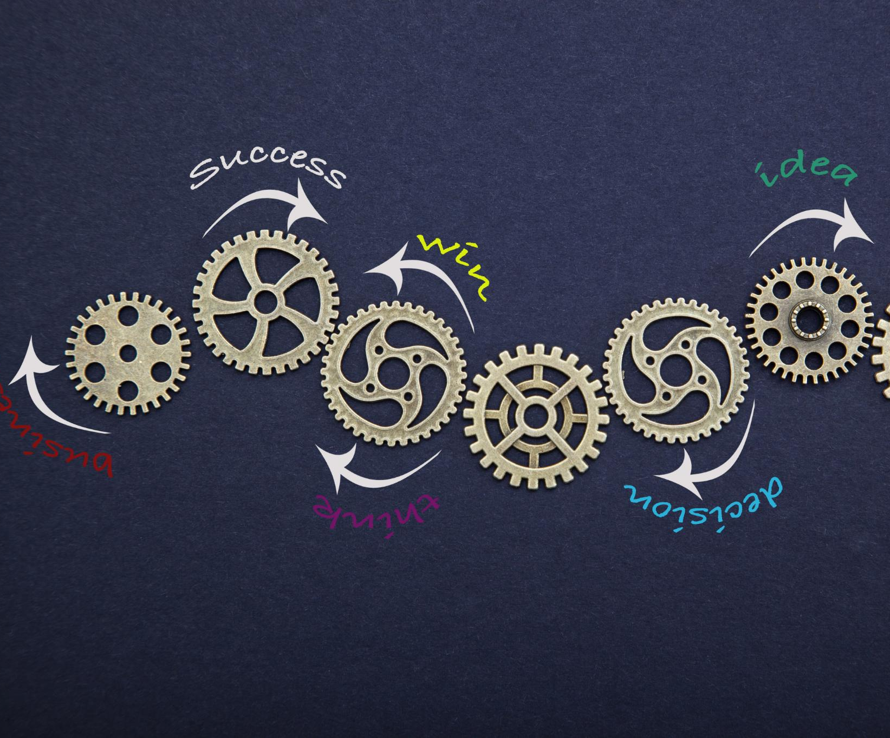
Potential for Further Adoption
Scaling and Expansion
Processes of similar nature, e.g., financial reporting request, review, & approval, or sales pitching, follow-up, transacting & approval, can adopt similar setup and scale or expand the demo to production use
Alternative AI-tool Exploration
N8n is one of the AI workflow platforms used in the demo. Other AI vendor software also can be explored to deliver similar capability, depending your budget and expertise
Notes:
--- Future opportunities include expanding automation to other procurement areas and refining AI capabilities to handle more complex scenarios seamlessly. Image source: Microsoft 365 content library

